Slide 1


تعديل الحوالات الصادرة
Field Drainage Application
Online-Offline

Slide 2
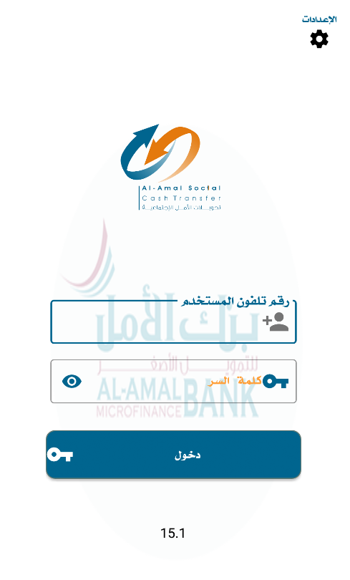
Login screen
1
Enter the user's phone number
2
Enter the password
3
Click on the Sign In button

Slide 3
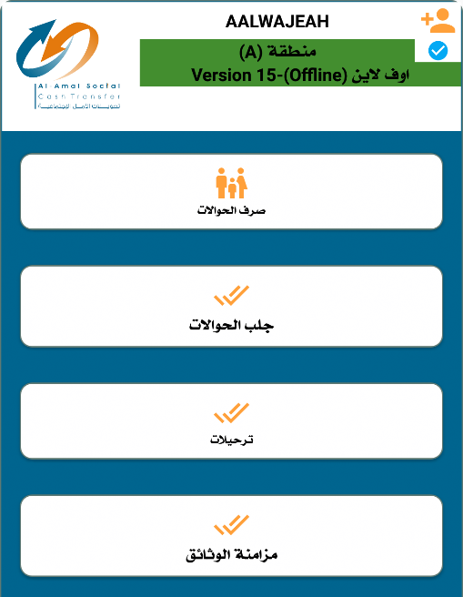
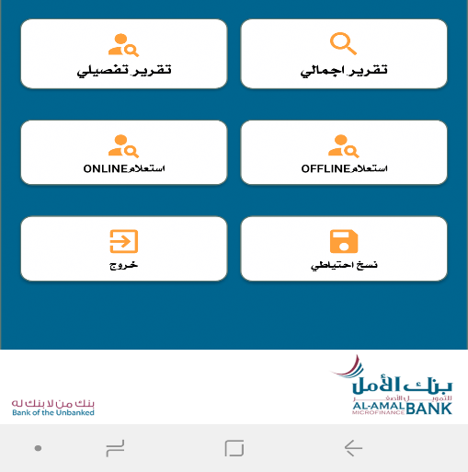
Home screen in the system

Slide 4
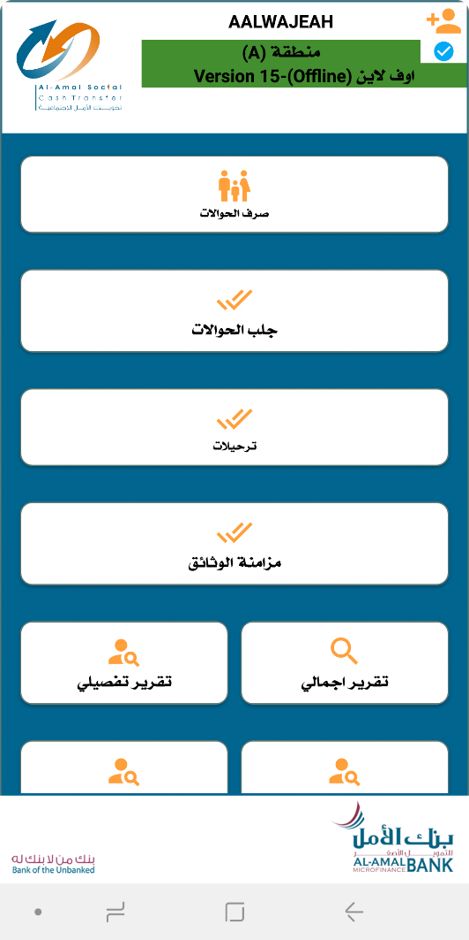
Data collection/matching/disbursement screen
To enter the disbursement screen, click on the icon showing transfer disbursement

Slide 5
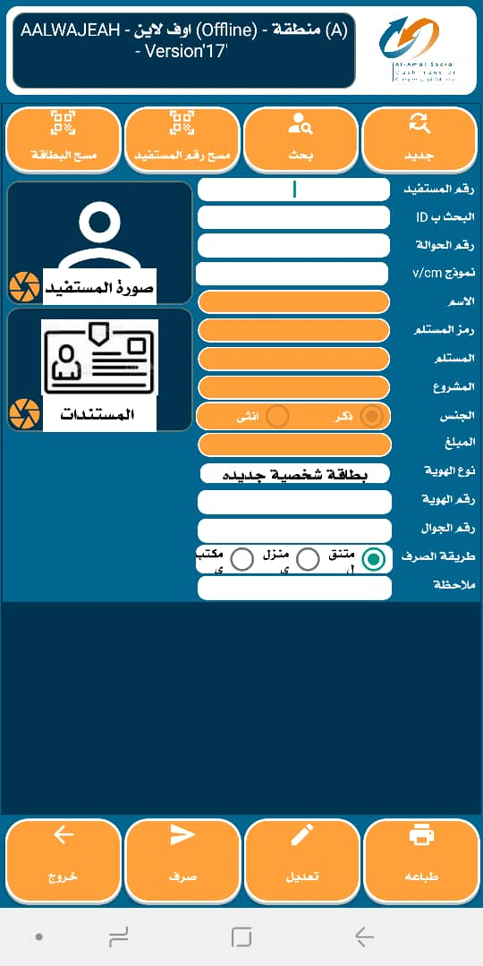
Exchange screen
Exchange screen To clear the screen, we press the New button
Exchange via barcode reading Determine the disbursement method
The beneficiary number, ID, or transfer number is written Then press the search button to fill the transfer information on the screen
Determine the disbursement method
When modifying a disbursement transfer, search by the transfer number or beneficiary number and then press the edit button to modify the disbursement information.
When the beneficiary's information is completed, the disbursement button is clicked to complete the disbursement process

Slide 6
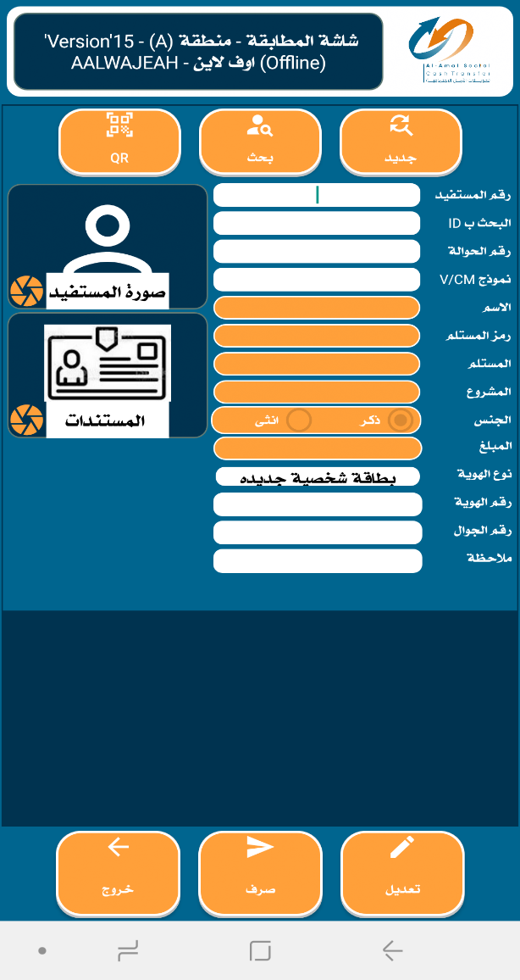
Exchange process
1
The beneficiary number or transfer number is written and then the execute button is pressed to fill the transfer information on the screen

Slide 7
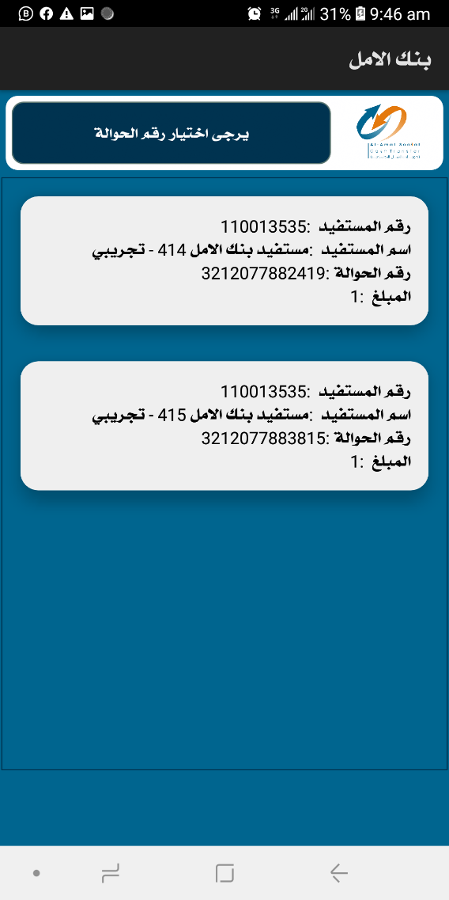
Exchange process
2
If you enter the beneficiary number and he has more than one transfer, this screen will appear containing all the beneficiary’s transfers, and one of the transfers will be selected to fill in its information in the matching screen.

Slide 8
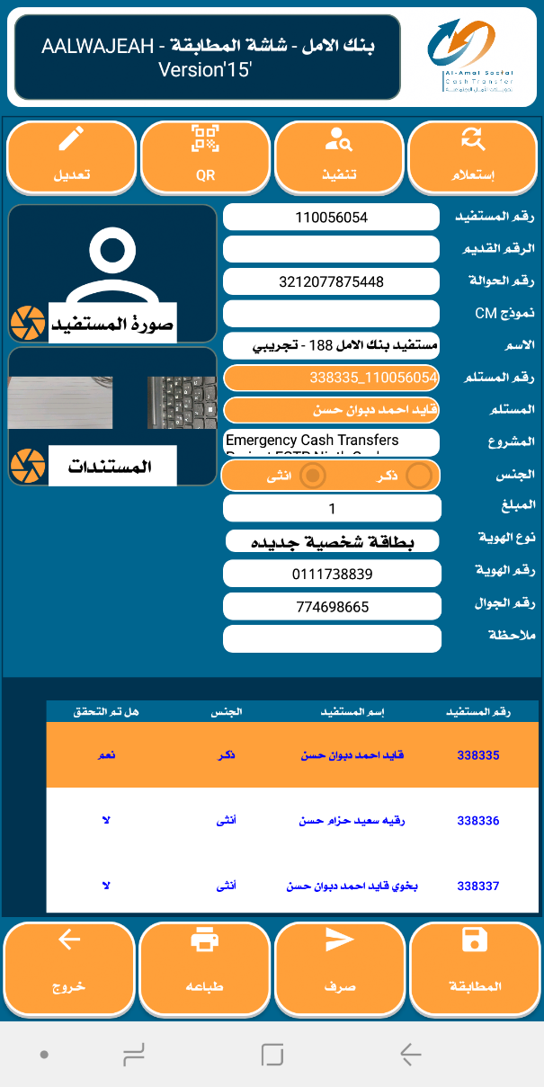



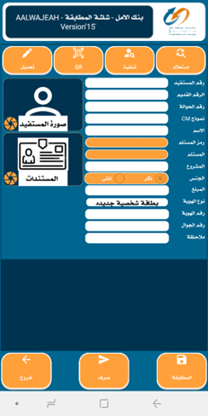
Exchange process
Enter the case management form if the system requests the form
Clearly depict the exchange proponents
Select the card type and enter its number
Enter the beneficiary's phone number correctly
Select the recipient's name from the Family Members table
After ensuring that all the required information is entered, click on the exchange icon

Slide 9
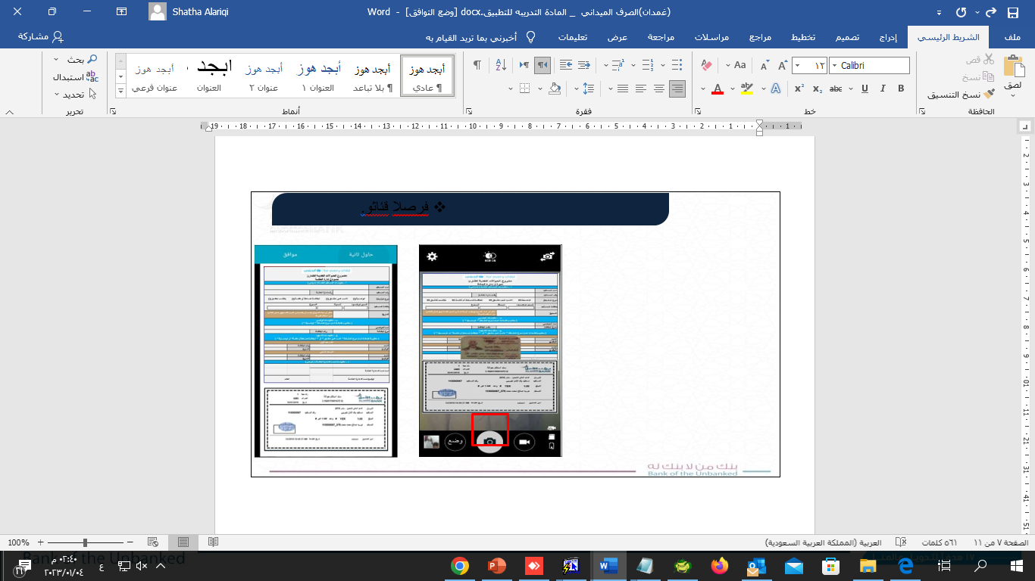
Exchange documents
Pictures of all exchange documents are taken in one picture or in the form of multiple pictures.

Slide 10
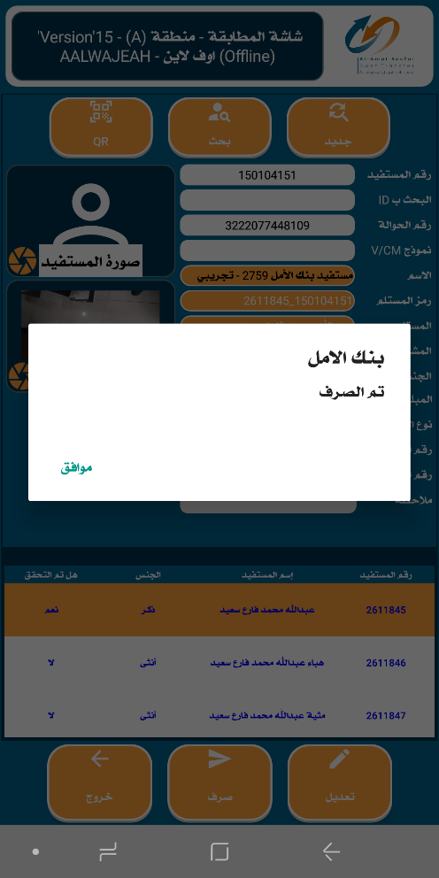
Exchange process
When all conditions are completed and the information is entered correctly, a notification will appear that the disbursement process has been completed Press the OK button

Slide 11

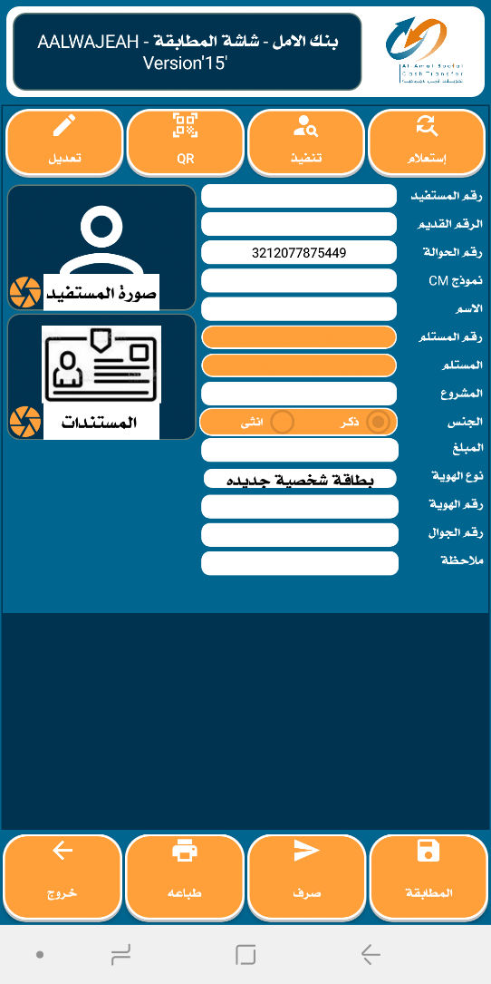
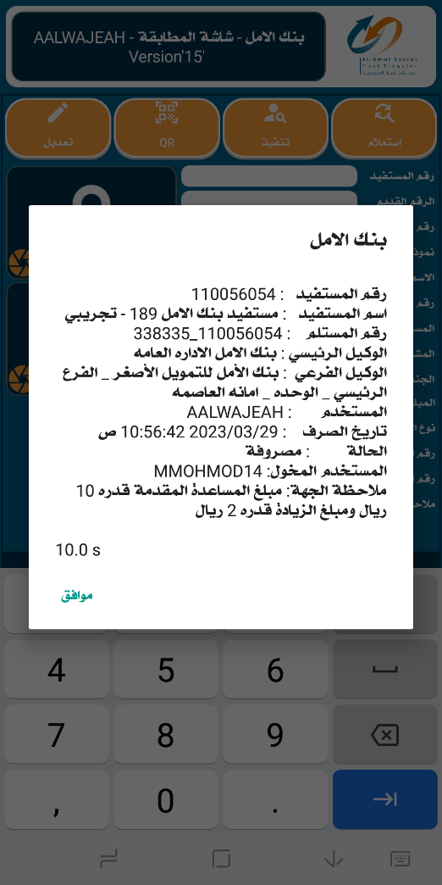


Exchange process
When you search by the transfer number and the transfer is disbursed, a notification with disbursement information will appear

Slide 12
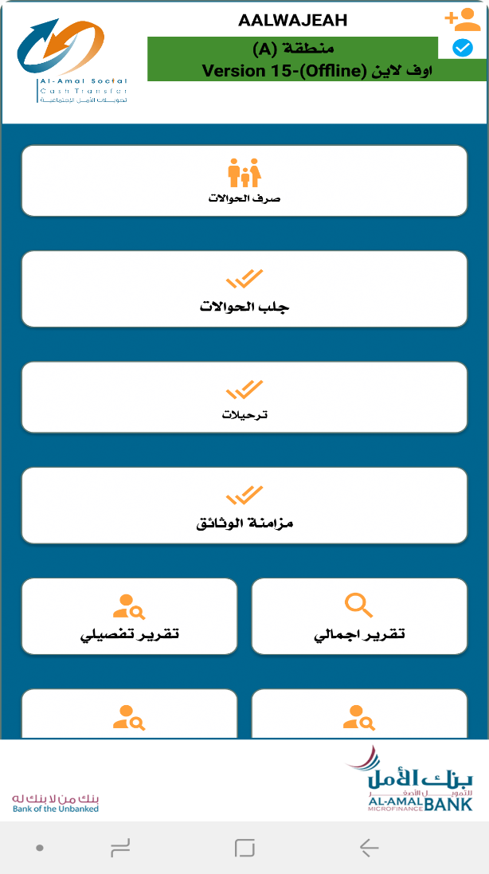
Transfer remittance screen: (for offline disbursement)
1
Click on the icon to bring remittances

Slide 13
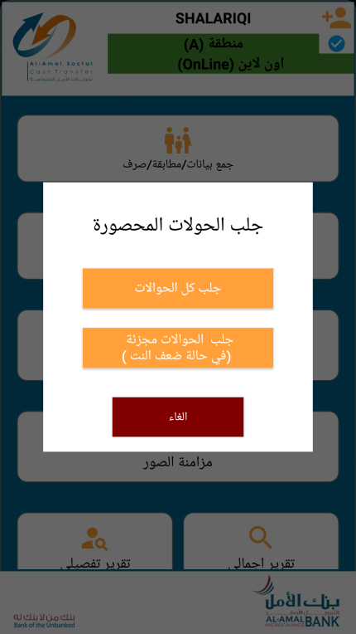
Transfer remittance screen: (for offline disbursement)
2
Click on one of the two icons Depending on the strength of coverage: Either bring all the remittances or Bring it in parts (50 transfers or more)

Slide 14
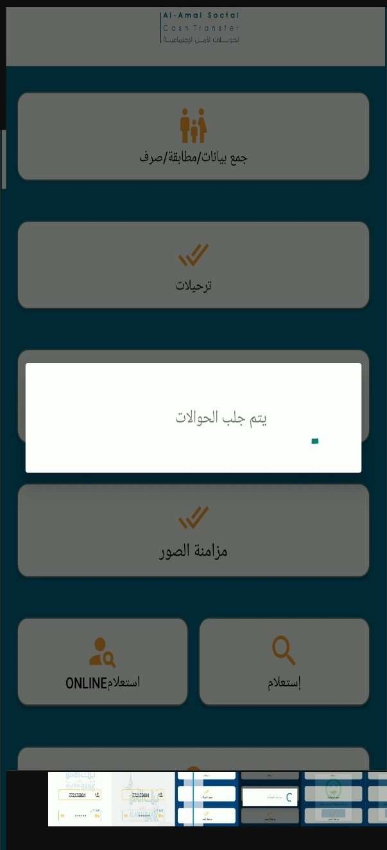
Transfer remittance screen: (for offline disbursement)
3
It waits until all transfers reserved for the user are fetched

Slide 15
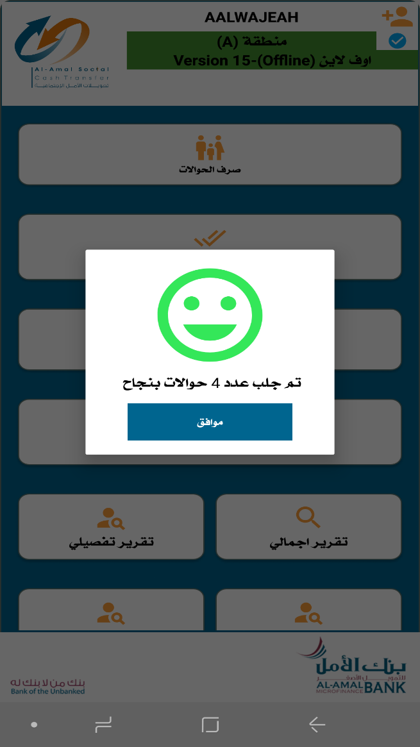
Transfer remittance screen: (for offline disbursement)
4
After all transfers are brought, a message will appear with the number of transfers received

Slide 16
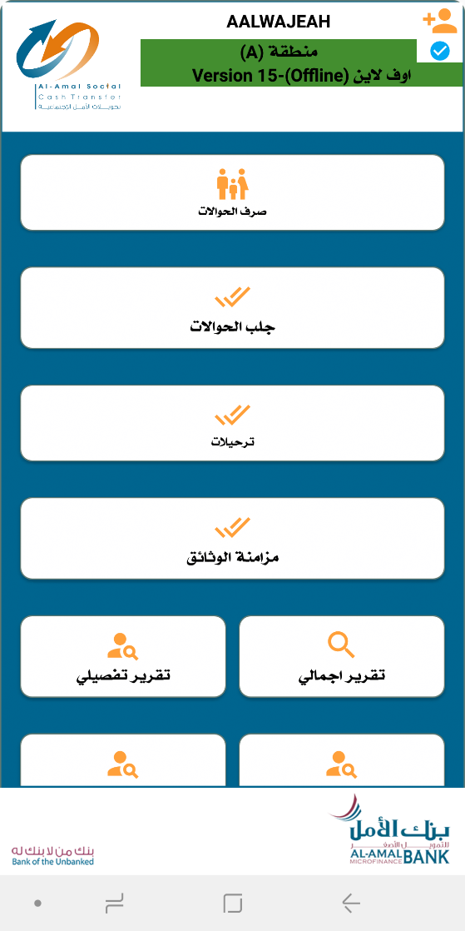
Data Migration(offline)
1
Click on the Postings icon on the main screen

Slide 17
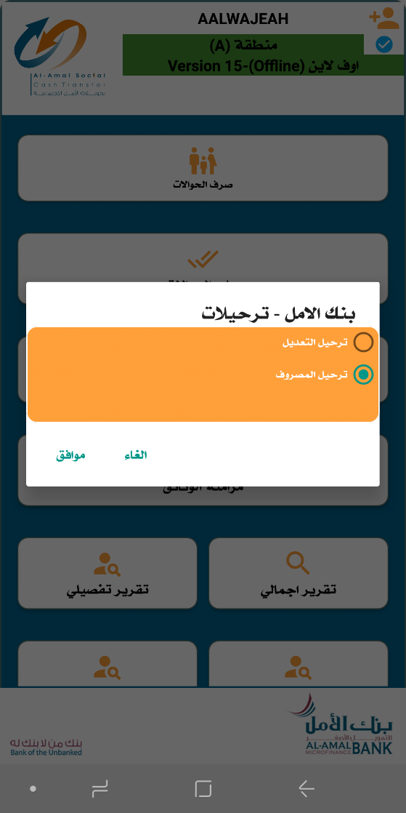
Data Migration(offline)
2
Click on Post the expense and then click on the OK button

Slide 18
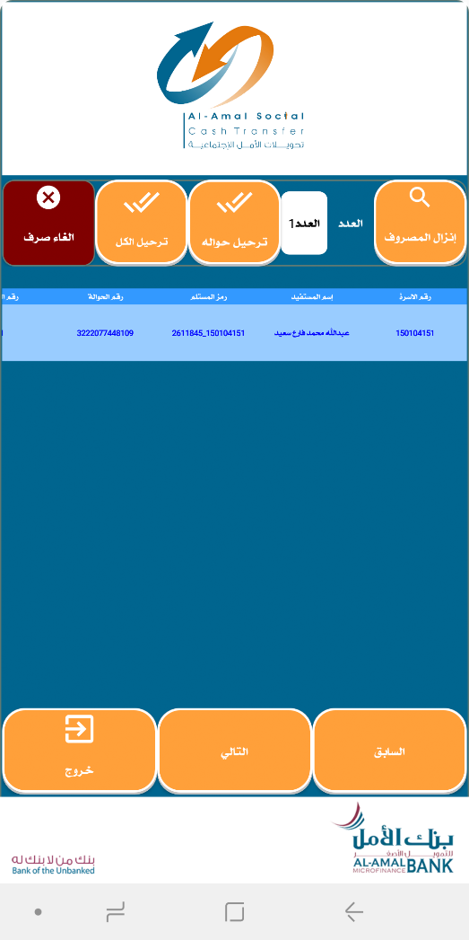
Click on Post Expense
4
3
The transfer process is carried out for each transfer separately, by selecting the transfer from the list and then clicking on Transfer
After the postings screen appears, click on Remove Expense to display the list of transfers whose data will be posted

Slide 19

Sync photos
1
After completing the disbursement and migration process, click on the Synchronize Documents icon to migrate photos and documents

Slide 20
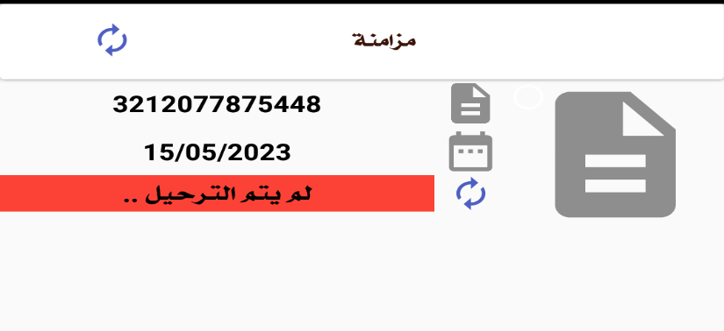
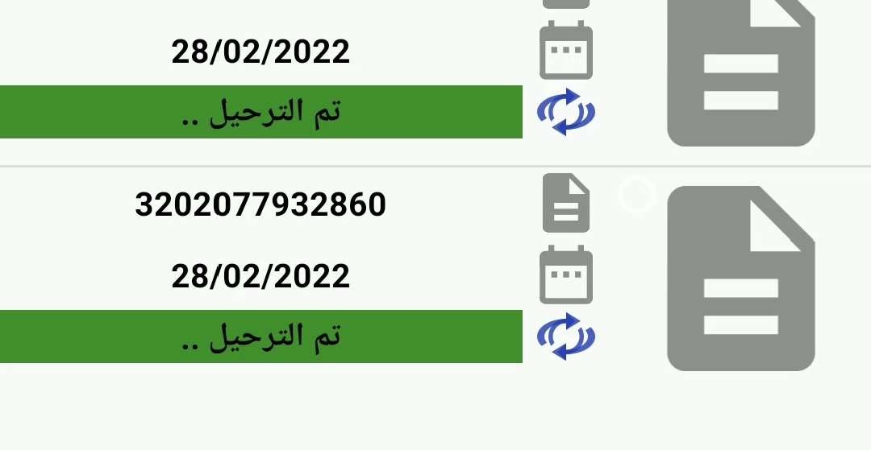
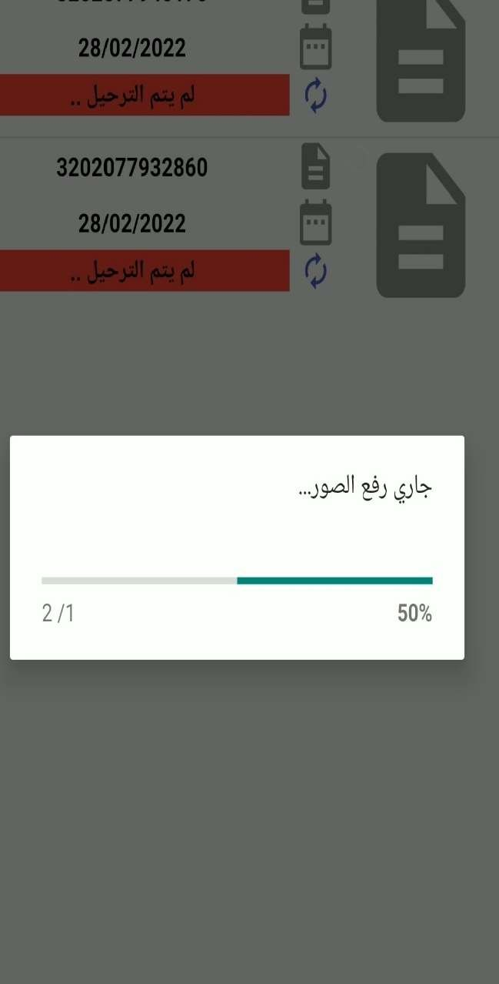
Sync photos
2
When you access the photo sync icon from the main screen, click the update button to upload all photos and documents

Slide 21

Overall report
To know the total report of posted and unposted transfers, click on this icon

Slide 22
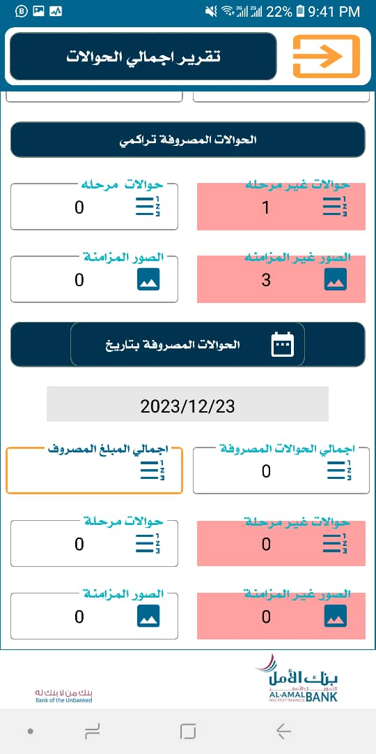
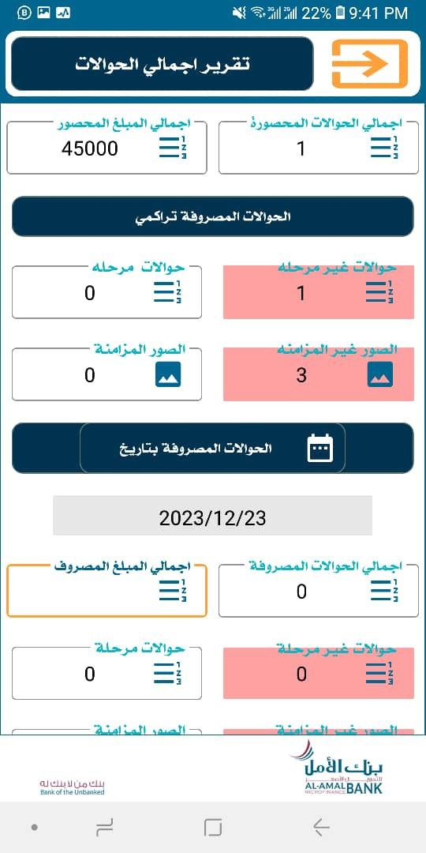
Total report screen

Slide 23
Detailed report
To know the detailed report of the disbursed transfers with the total amount and the total number disbursed on a specific date, click on this icon.

Slide 24
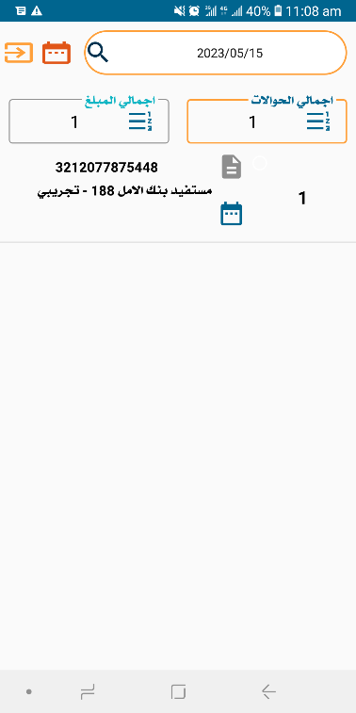
Detailed report screen
Through the detailed reports screen, the total number of transfers and the total amounts are displayed by searching for the disbursement date and clicking on Inquire to retrieve the total along with displaying the numbers of transfers disbursed on this date.

Slide 25


Online inquiry
To know the information about an online transfer, whether it is paid or not, and other information, click on this icon.

Slide 26
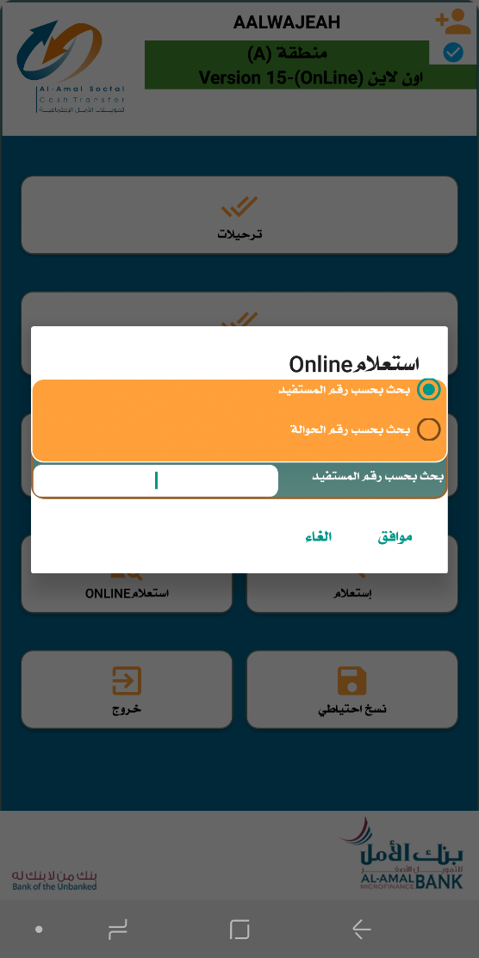
Online inquiry screen
In the case of online disbursement, the system is inquired directly according to (beneficiary number, transfer number) so that the beneficiary data is retrieved from the system and then the OK button is pressed.

Slide 27


Offline query
To know the information about the offline transfer, whether it is spent or not, and other information, click on this icon.

Slide 28

Inquiry screen
1
2
Choose one of the options shown in the image for the number you want to search by from here
The number is entered here
3
The inquiry button is pressed to display the information

Slide 29
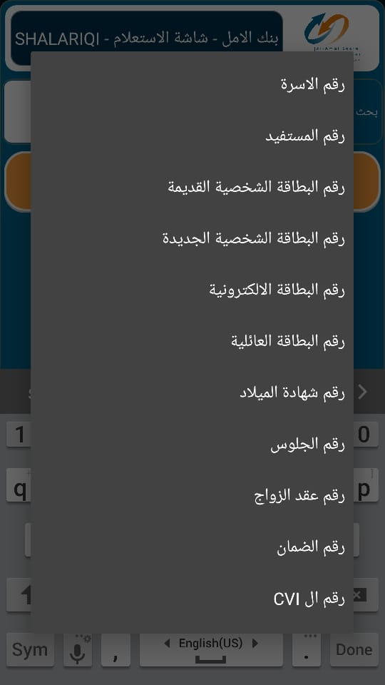
Inquiry screen
Options through which you can search for beneficiary information

Slide 30

Backup
Through this icon, a backup copy of the device’s internal data can be made, provided that the user has permission to make a backup copy.

Slide 31
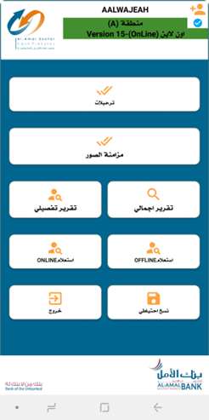
Online inquiry
Using the exit icon we can exit the application

